Slide 1
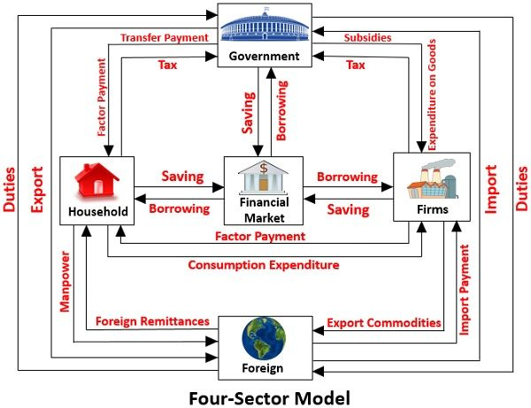

Slide 2
National Income
National income is the total money value of all goods and services produced by a nation during one year after deducting the depreciation value of the machine used in production.
National income is the total payments received by the factors of production through the production of goods and services in a country in a year.
National income as a total net output of the nation.

Slide 3
Concepts of national income
Gross domestic product
Gross national product
Net national product
National income at factor cost
Personal income
Disposable income

Slide 4
Gross domestic product
Total market value of all final goods and services produced by factors of production in a country over a given period of time.
GDP exclude goods and services produced by Indian citizens working overseas as well as intermediate goods.

Slide 5
Gross national product
Total market value of all final goods and services produced by the residents of a country during a given period of time.
GNP is the total amount of income earned by national of the country regardless of where they are.
GNP= GDP+ net factor income from abroad
GNP= GDP+ (factor income from abroad- factor income paid abroad)

Slide 6
Income earned by the Indians working in Canada, America, Singapore and other countries will be
Included in GNP of the country
Excluded from the GNP of the country

Slide 7
Market price and factor cost
Market price refers to the current price in the market through the forces of demand and supply.
Market prices are actual prices paid by consumers
Market prices includes indirect taxes and excludes subsidies given to producers

Slide 8
Important point of adjustment
GDP at factor cost= GDP_{MP}-indirect taxes+ subsidies
GDP at market price= GDP_{FC}+ indirect taxes-subsidies

Slide 9
Net national product
The market value of the net output of goods and services produced by a nation in a year.
NNP_{MP}= GNP_{MP}- depreciation

Slide 10
National income at factor cost
Total of all income payments made to factors of production.
National income= NNP at market cost+ subsidies-indirect taxes

Slide 11
Personal income
Personal income is the income that is actually received by individuals and households in an economy in a year.
Corporate income taxes- a certain portion of corporate profits that are paid out as corporate income tax before being distributed among shareholders.
Retained earnings- that part of corporate profits retained by corporations and distributed among shareholders.
Social security contributions- contributions of a certain percentage of the worker’s income to provident funds or pension funds.
Insurance premium- a certain percentage of income that is used to pay for insurance.
Transfer payment- government give some social security benefits such as unemployment allowances, old age pensions and other benefits to the public.

Slide 12
Personal income= National income+ transfer payments- corporate income taxes- retained earnings- social security contributions- insurance premium

Slide 13
Disposable income
Part of personal income that is left after the payment of personal direct taxes.
Disposable personal income= Personal income – personal income tax

Slide 14
Measurement of national income
Expenditure method
Income method
Product method

Slide 15
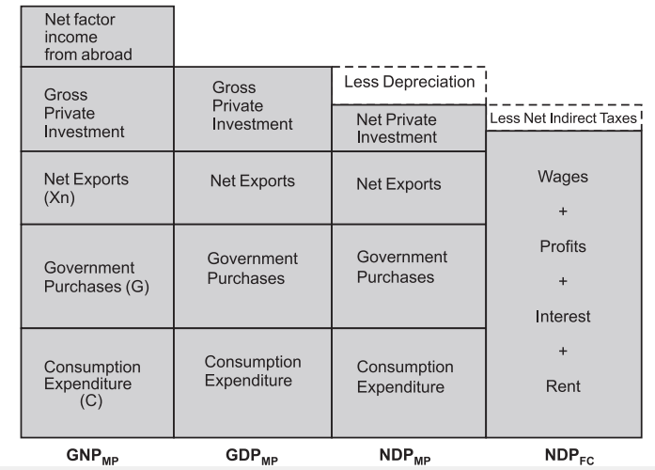
Various Concepts of National Product

Slide 16
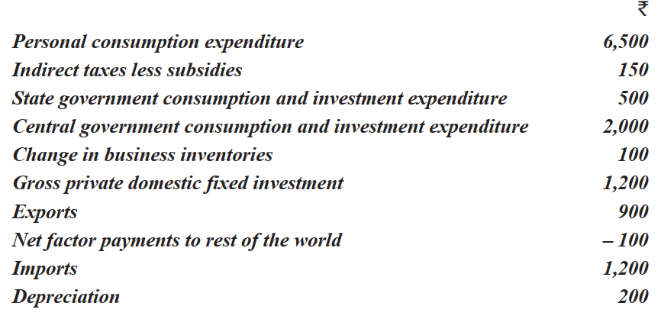
Q) Calculate (1) GDP at market prices and (2) national income from the following information for the year 2021, Cr. Rupees?

Slide 17
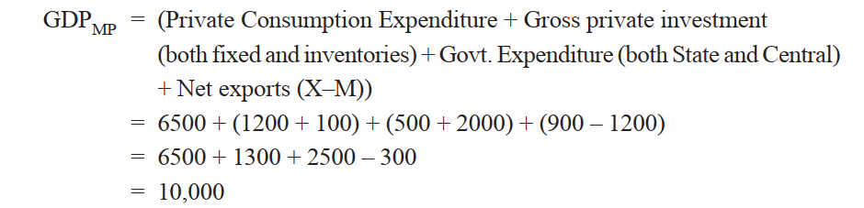
Solution....

Slide 18
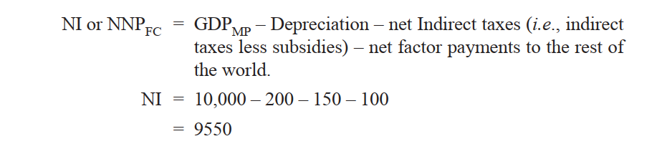

Slide 19
MEASUREMENT OF NATIONAL INCOME
Value Added Method Gross Value Added at Market Prices (GVAMP)
Gross value added at market prices (GVAMP) = Value of Output – Intermediate Consumption Net Value Added at Market Prices (NVAMP)
NVAMP = GVAMP – Consumption of Fixed Capital i.e. Depreciation Net Value Added at Factor Cost (NVAFC)
NI or NNPFC = NDPFC + Net factor income from abroad

Slide 20
Precautions
The following precautions should be taken while measuring national income of a country through value added method:
1. Imputed rent values of self-occupied houses should be included in the value of output. Though these payments are not made to others, their values can be easily estimated from prevailing values in the market.
2. Sale and purchase of second-hand goods should not be included in measuring value of output of a year because their values were counted in the year of output of the year of their production. Of course, commission or brokerage earned in their sale and purchase has to be included because this is a new service rendered in the current year.

Slide 21
Conti.....
3. Value of production for self-consumption are to be counted while measuring national income. In this method, the production for self-consumption should be valued at the prevailing market prices.
4. Value of services of housewives are not included because it is not easy to find out correctly the value of their services.

Slide 22
Income Method
Thus, under this method, national income is obtained by summing up of the incomes of all individuals of a country.
Individuals earn incomes by contributing their own services and the services of their property such as land and capital to the national production.

Slide 23
Classification the factor payments
1. Compensation to employees which includes wages and salaries, employers’ contribution to social security schemes. 2. Rent and also royalty, if any. 3. Interest. 4. Profits: Profits are divided into three sub-groups: (i) Dividends (ii) Undistributed profits (iii) Corporate income tax

Slide 24
5. Mixed income of the self-employed: In India, as in other developing countries, there is fifth category of factor income which is termed as mixed income of self-employed.
In India a good number of people are engaged in household industries, in family farms and other unorganised enterprises.
Because of self-employment nature of the business it is difficult to separate wages for the work done by the self-employed from the surplus or profits made by them. Therefore, the incomes earned by them are mix of wages, rent, interest and profit and are, therefore, called mixed income of the self-employed.

Slide 25
Conti..
3. Now the step is to measure factor payments. Income paid out by each enterprise can be estimated by gathering information about the number of units of each factor employed and the income paid out to each unit of every factor. Price paid out to each factor multiplied by the number of units of each factor employed would give us the factor’s income.
4. By summing up the incomes paid out by all industrial sectors we will obtain domestic factor income which is also called net domestic product at factor cost (NDPFC).
5. Finally, by adding net factor income earned from abroad to domestic factor income or NDPFC we get net national product at factor cost (NNPFC) which is also called national income.

Slide 26
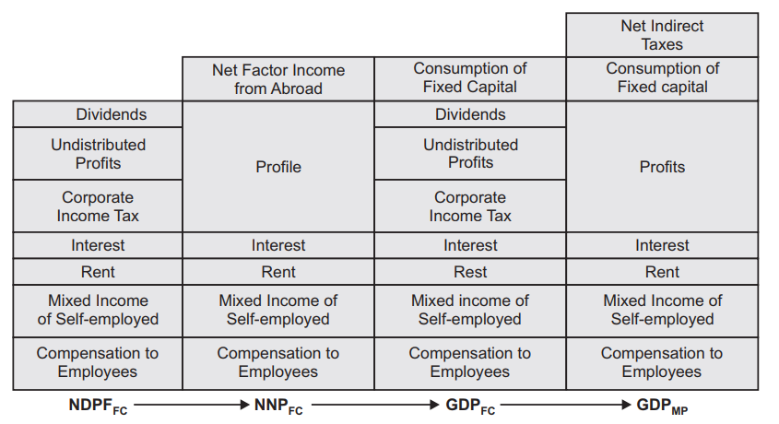
Income Approach to National Income

Slide 27
Conti.....
Precautions. While estimating national income through income method the following precautions should be taken: 1. Transfer payments are not included in estimating national income through this method. 2. Imputed rent of self-occupied houses are included in national income as these houses provide services to those who occupy them and its value can be easily estimated from the market value data. 3. Illegal money such as hawala money, money earned through smuggling etc. are not included as they cannot be easily estimated. 4. Windfall gains such as prizes won, lotteries are also not included.

Slide 28
Conti....
5. Corporate profit tax (that is, tax on income of the companies) should not be separately included as it has already been included as a part of profits.
6. Death duties, gift tax, wealth tax, tax on lotteries, etc., are paid from past savings or wealth and not from current income. Therefore, they should not be treated as a part of national income of a year.
7. The receipts from the sale of second-hand goods should not be treated as a part of national income. This is because the sale of second-hand goods does not create new flows of goods and services in the current year.
8. Income equal to the value of production used for self consumption should be estimated and included in the measure of national income.

Slide 29
Expenditure Method
We add up the following types of expenditure by households, government and by productive enterprises to obtain national income:
Expenditure on consumer goods and services by individuals and households. This is called final private consumption expenditure, and is denoted by C
Government’s expenditure on goods and services to satisfy collective wants. This is called government’s final consumption expenditure, and is denoted by G.

Slide 30
Conti....
The expenditure by productive enterprises on capital goods and inventories or stocks. This is called gross domestic capital formation, or gross domestic investment and is denoted by I or GDCF. Gross domestic capital formation is divided into two parts: (i) Gross fixed capital formation (ii) Addition to the stocks or inventories of goods
The expenditure made by foreigners on goods and services of a country exported to other countries which are called exports and are denoted by X.
We deduct from exports (X) the expenditure by people, enterprises and government of a country on imports (M) of goods and services from other countries. That is, we have to estimate net exports (that is, exports– imports) or (X—M).

Slide 31
Conti....
GDPMP = Private final consumption expenditure + Government’s final consumption expenditure + Gross domestic capital formation + Exports – Imports or GDP MP = C + G + I + (X — M) = C + G + I + Xn
On deducting consumption of fixed capital (i.e., depreciation) from gross domestic product at market prices (GDPMP) we get net domestic product at market prices (NDPMP).

Slide 32
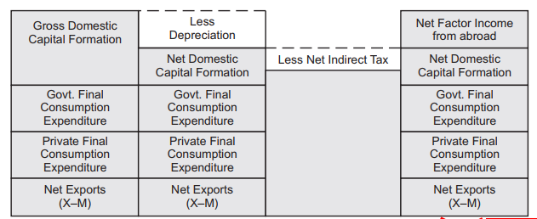
**In this method, we then subtract net indirect taxes (that is, indirect taxes – subsidies) to arrive at net domestic product at factor cost (NDPFC)**

Slide 33
Precautions
While estimating Gross Domestic Product through expenditure method or measuring final expenditure on Gross National Product, the following precautions should be taken:
1. Second-hand goods: The expenditure made on second-hand goods should not be included because this does not contribute to the current year production of goods and services. 2. Purchase of shares and bonds. Expenditure on purchase of old shares and bonds from other people and from business enterprises should not be included while estimating Gross Domestic Product through expenditure method.

Slide 34
Conti.....
3. Expenditure on transfer payments by government such as unemployment benefits, old-age pension should also not be included because no goods or productive services are produced in exchange by the recipients of these payments.
4. Expenditure on intermediate goods such as fertilisers and seeds by the farmers and wool, cotton and yarn by manufacturers of garments should also be excluded to avoid double counting.

Slide 35
Product Approach
National income is measured by net value of final goods and services produced by a nation during a year.
This approach is also known as output approach and value added approach.
Money value of final goods and services are included in calculation of GDP of the country.

Slide 36
Sectors contributing to GDP
Primary sector
Secondary sector
Tertiary sector

Slide 37
Tertiary sector comprising
Electricity
Gas and water
Wholesale and retail trade
Finance
Insurance, real estate and business services
Transport, storage and communication
Government services and other services

Slide 38
GDP at market price= All final products in the economy
GNP at MP= GDP +NFIA
GNP at FC= GNP at MP- Indirect taxes+ subsidies
National income= GNP at FC – depreciation
Personal income= national income+ transfer payments- corporate income taxes- retained earnings – social security contributions- insurance premium
Disposable income= personal income- personal income tax

Slide 39
Uses of National Income
Standard of living comparison
Economic performance over time
National planning
Sectoral contributions
Economic policy
Inflationary and deflationary gaps
Public sector
Distribution of income

Slide 40
Difficulties in calculation of national income
Problem of non-monetized sector
Problem of illiteracy
Problem of expertise
Problem of less sophisticated machinery
Problem of double counting
Problem of false information
Problem of multi-occupation

Slide 41
Circular flow of money
In the modern economy, money is used in the process of exchange.
Money has facilitated the process of exchange and has removed the difficulties of the barter system.
Thus money acts as a medium of exchange.
The households supply the economic resources or factors to the productive firms and receive in return the payments in terms of money.

Slide 42
Circular Income Flow in a Two-Sector Economy
It is assumed that all incomes which households receive are spent on consumer goods and services and thus there is no savings by them.
The resources such as land, capital and entrepreneurial ability flow from households to business firms. In opposite direction to this, money flows from business firms to the households as factor payments such as wages, rent, interest and profits.
Money flows from households to firms as consumption expenditure made by the households on the goods and services produced by the firms, while the flow of goods and services is in opposite direction from business firms to households.

Slide 43
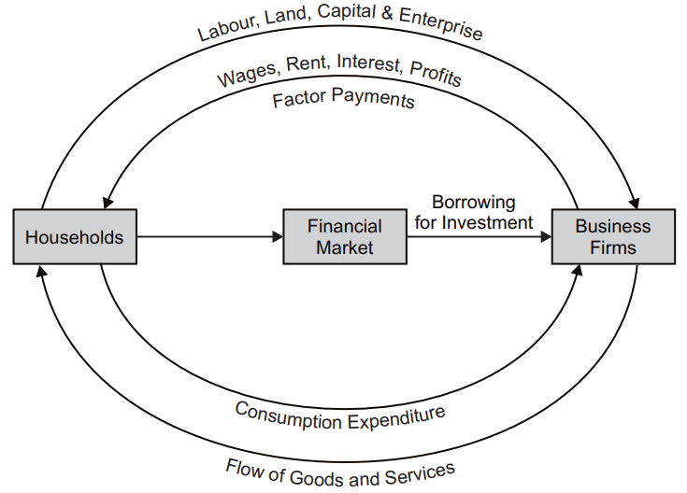

Slide 44
Important facts
Flow of money income will not always remain the same in volume.
The flow of money income will not always continue at a constant level.
In years of depression, the circular flow of money income will contract, i.e., will become lesser in volume, and in years of prosperity it will expand, i.e., will become greater in volume.
This is so because the flow of money is a measure of national income and will, therefore, change with changes in the national income.
In years of depression, when national income is low, the volume of the flow of money will be small and in years of prosperity when the level of national income is quite high, the flow of money will be large.

